Slide 1
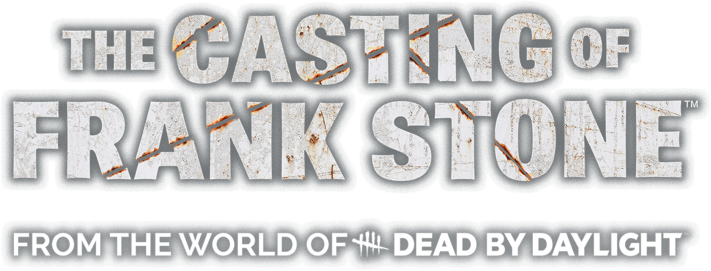
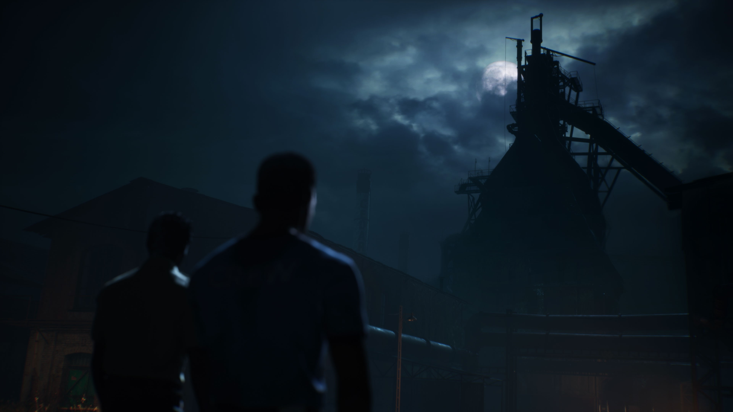


Induvial Dev Log
By Sidd

Slide 2
Project Outline
The project involves a small, interdisciplinary team of 8 individuals collaborating to create a game inspired by Supermassive Games's The Casting of Frank Stone. The core concept centers around leveraging diverse expertise to develop a unique gaming experience, blending elements of narrative, gameplay, and visuals in a cohesive manner. The purpose of the project is to combine creative minds from various fields to produce a compelling and engaging game.
The project’s initial goals focus on building a strong foundation for the game by defining its core gameplay mechanics, crafting an engaging narrative, and developing a visually appealing aesthetic. The team will create a playable prototype that showcases these elements, allowing for early testing and iteration. Effective communication and project management are crucial to ensure smooth collaboration among the interdisciplinary team. The ultimate objective is to refine the game through continuous feedback, blending the strengths of each team member to produce a compelling and cohesive final build inspired by The Casting of Frank Stone.
The primary challenge anticipated during development is the risk of being too ambitious. If the team sets overly ambitious goals or incorporates features that exceed the scope of what can be realistically achieved within the given timeframe, there is a chance the project may not be completed by the deadline. Ensuring a balance between ambitious ideas and achievable milestones will be crucial to maintaining progress and delivering the game on time.

Slide 3
Research (Week 1)
For this project, I conducted extensive research on the source material, The Casting of Frank Stone, specifically on its gameplay mechanics to create a more immersive experience like the source material. I prioritized watching an entire gameplay walkthrough to develop an understanding of the source material.
Additionally, I researched into horror and interactive narrative gameplay mechanics to deepen my understanding of genres mechanics and ensure its proper implementation within the game.

Slide 4
Research: The Casting of Frank Stone (Week 1)
"The Casting of Frank Stone" is a collaborative effort between Supermassive Games, renowned for their interactive horror titles like "Until Dawn" and "The Quarry," and Behaviour Interactive, the creators of the popular multiplayer horror game "Dead by Daylight." Released on September 3, 2024, this game merges Supermassive's narrative-driven gameplay with the expansive lore of "Dead by Daylight." Critically, the game has received mixed to average reviews, with a Metascore of 68 based on 31 critic reviews and a user score of 5.7 from 156 ratings on Metacritic. While some reviewers praise its engaging narrative and atmospheric design, others point out issues such as underdeveloped characters and technical glitches. Despite these critiques, the game offers a unique experience for fans of both developers, expanding the "Dead by Daylight" universe through Supermassive's cinematic storytelling approach.
The movement system in The Casting of Frank Stone emphasizes exploration and environmental interaction, featuring walking, running, vaulting, climbing, balancing, crouching, and squeezing through gaps to enhance pacing, stealth, and verticality. The game’s systems include a binary-choice dialogue system that influences character relationships, a minimalist inventory system with no UI, a search scan system for locating objects, and an objective system for guiding players while maintaining immersion. Core mechanics such as quick-time events (QTEs), puzzles, and interactive items like flashlights and movable crates contribute to engagement and tension. Interactions include collectibles that expand the lore and a first-person interaction camera for inspecting objects up close. Although I haven’t played the game, I analysed a YouTube walkthrough to document its mechanics for my team, as understanding these systems is essential for our project. Since I will be programming some of these features, studying their implementation in The Casting of Frank Stone provides valuable insight into how they function in a horror game setting.
The gameplay mechanics in The Casting of Frank Stone align closely with Supermassive Games' interactive storytelling approach, blending exploration, decision-making, and cinematic horror to create an engaging and immersive experience. The movement system enables fluid traversal, while environmental storytelling, suspense, and player agency enhance engagement. The game effectively merges Supermassive Games' narrative-driven style with Dead by Daylight’s dark universe, delivering atmospheric world-building, tense exploration, and choice-driven storytelling. The first-person interaction mechanic adds to the immersion, and the minimal inventory system keeps gameplay streamlined. However, some mechanics, like QTEs, feel overused, making certain sequences predictable rather than thrilling, and while the dialogue system offers choices, their impact often feels limited. Despite these drawbacks, the game’s eerie storytelling and immersive design make for a compelling experience, though some areas could have been refined for greater dynamism.

Slide 5
Research: Horror Game Mechanics (Week 1)
TheGamer, established in 2017 by Valnet Inc., has rapidly positioned itself as a prominent digital gaming publication, offering a blend of in-depth guides, timely news, and insightful reviews across the gaming spectrum. Recognized for its extensive walkthroughs and features, TheGamer caters to a diverse gaming audience. However, its reception among readers is mixed; while some appreciate its comprehensive content, others critique its editorial stance and review methodologies. On Trustpilot, the site holds an average rating of 3.1 from six reviews, with feedback ranging from praise for its guides to concerns about perceived biases. Similarly, Scamadviser assigns TheGamer a positive trust score, noting its legitimacy and safety, yet highlights several negative consumer reviews. Despite these varied perspectives, TheGamer maintains a significant presence in the gaming community, continually influencing and informing its readership.
Horror games utilize various mechanics to heighten tension and fear, creating immersive and anxiety-inducing experiences. Five Nights at Freddy's 2 exemplifies task juggling, forcing players to balance multiple objectives under pressure, while heart rate monitoring in Nevermind dynamically adjusts difficulty based on the player's physiological responses. Quick Time Events (QTEs) simulate high-stakes moments, requiring rapid reflexes, whereas jump scares deliver sudden shocks through unexpected visuals and sounds, a staple in games like Five Nights at Freddy’s. Chase sequences, seen in Poppy Playtime, evoke primal fear by making players flee relentless adversaries, while keeping quiet intensifies suspense by punishing noise. Hiding mechanics, such as in Alien: Isolation, emphasize vulnerability, and camera flash mechanics reveal dangers lurking in darkness, enhancing dread. Resource management plays a role in light source depletion, as in Amnesia: The Dark Descent, where players must conserve matches or batteries, while staying out of darkness becomes a survival necessity when shadows threaten sanity or health. Subtler fears emerge with something peering from around a corner, evoking the terror of being watched, and no pausing ensures relentless tension by keeping players vulnerable even in menus. Lastly, enemies that only move when unobserved create a uniquely terrifying dynamic, requiring constant vigilance to prevent their advance, demonstrating how horror games masterfully manipulate uncertainty and control to sustain fear.
The article "13 Most Intense Horror Game Mechanics" from TheGamer provides an engaging overview of gameplay elements that heighten tension in horror games. I appreciated the inclusion of unique mechanics, such as heart rate monitoring in Nevermind, which adapts to the player's physiological responses to enhance immersion. However, the list could have explored the psychological impact of these mechanics in greater depth, offering more analysis on how they shape player experiences. Additionally, while the article covers a range of well-known horror games, it might have benefited from discussing lesser-known titles that utilize innovative mechanics, providing a broader perspective on the genre.

Slide 6
Research: Interactive Narrative Game Mechanics (Week 1)
The source "Interactive Storytelling: Narrative Mechanics – The Gears of Imagination" published on FasterCapital's website explores the concept of narrative mechanics in interactive storytelling, focusing on how these structural components influence the player's experience in shaping a story. FasterCapital is a prominent global accelerator and venture building platform, known for fostering technology startups. While the platform offers insightful content for developers, its articles are primarily aimed at entrepreneurs and innovators. The source provides an informative overview of the role of narrative mechanics in interactive storytelling, making it a valuable resource for game developers, writers, and those interested in narrative design. However, as the website is more business-focused and does not specialize in academic discourse or game development, its authority might be questioned in comparison to more established academic journals or renowned industry experts. Despite this, the source offers practical insights, contributing to the ongoing dialogue surrounding interactive media and narrative construction.
Narrative-driven games employ various mechanics to create immersive and interactive storytelling experiences. Choice and consequence shape the storyline, allowing players to influence outcomes and craft personalized experiences, while branching narratives adapt based on decisions, offering multiple story paths and endings. Environmental storytelling uses the game world to convey narrative elements, with settings and objects providing context and background. Dynamic character development ensures that characters evolve based on player interactions, fostering deeper emotional connections. Puzzle solving integrates challenges within the narrative, advancing the story while enhancing engagement. Narrative feedback reinforces player impact by providing immediate responses through environmental changes, character reactions, or story shifts. Player agency grants players control over the story’s direction, increasing immersion, while non-linear time presents events out of chronological order, encouraging players to piece together the narrative for a more engaging experience.
I found the article "Interactive Storytelling: Narrative Mechanics – The Gears of Imagination" to be an insightful read, particularly in how it underscores the importance of narrative mechanics in interactive storytelling. I appreciated the clear explanation of how player agency and decision-making can shape the direction of a story, which resonates with my interest in game development and the creative process. The article effectively captures the essence of interactive storytelling and emphasizes the evolving nature of narrative design in games. However, I did feel that the source could benefit from more in-depth examples or case studies from well-known games to illustrate its points. While the article offers a solid foundation, I would have liked to see more practical insights that tie directly to specific game mechanics or design choices. Nonetheless, I agree with the overall premise that narrative mechanics are essential for creating engaging and dynamic player experiences.

Slide 7
Implementation: Sprinting & Crouching (Week 2)
Sprinting & Crouching blueprint handles character movement mechanics, specifically sprinting and crouching, using the Enhanced Input system. The top section listens for the IA_Sprint input action, setting the Is Sprinting boolean accordingly. An Event Tick node continuously checks if the player is sprinting; if true, it sets the character’s Max Walk Speed to 500, otherwise, it defaults to 250. The bottom section listens for the IA_Crouching input action, toggling the Is Crouching boolean. A branch node determines whether the player should crouch or uncrouch, calling the corresponding Crouch or UnCrouch functions. These mechanics dynamically adjust the player's movement speed and stance based on input.

Slide 8
Implementation: Checkpoint System (Week 2)
Collision with Checkpoint blueprint handles a checkpoint system using an overlap event. When the player enters a trigger box, the OnComponentBeginOverlap event is triggered. It first retrieves the instigating actor and attempts to cast it to BP_ThirdPersonCharacter_C to ensure that the overlapping actor is the player character. If the cast is successful, it then retrieves the game instance by casting to BP_GameInstance_C. The script then saves the player's current world transform as the respawn location by using GetWorldTransform on a scene component, storing this data in the game instance. Finally, it sets a boolean variable Checkpoint On to true, indicating that the checkpoint has been activated. This setup ensures that when the player reaches a checkpoint, their position is saved for potential respawn or continuation.
Setting Respawn Position blueprint handles the player's respawn system using the saved checkpoint data. The Event BeginPlay node is triggered when the game starts. It first retrieves the game instance by casting it to BP_GameInstance_C and checks if the Checkpoint On boolean is set to true. If a checkpoint was previously activated, the script retrieves the saved respawn transform (location, rotation, and scale) and applies it to the player using the SetActorTransform node, ensuring the player starts at the last checkpoint position. The script then enables player input by calling Enable Input and passing the player controller. Lastly, it sets the player's mesh visibility to ensure they are properly displayed after respawning. This system ensures that when the game begins, the player is repositioned at the last checkpoint if one exists.

Slide 9
Implementation: Button Mashing QTE Mechanic (Week 3)
g

Slide 10
Implementation: Flash Mechanic (Week 4)
Toggle Aiming Function toggles a character's aiming mode by adjusting camera properties and visibility. When Toggle Aiming is triggered, it updates the Is Aiming Boolean and checks its value. If true, the camera's Field of View (FoV) is set to Aim FOV, the camera position shifts to aiming coordinates, and Is in Camera Mode is enabled. The character mesh is hidden, and the camera boom shortens to 0.0 for a closer view. If false, it resets the FoV to default, restores the camera position, disables Is in Camera Mode, makes the mesh visible, and extends the camera boom to 400.0, returning to third-person mode. This setup enables smooth transitions between third person and first person.
Trigger Flash Function handles a flash effect by adjusting the intensity of a light component. The process starts with the Trigger Flash event, which activates the Set Intensity function. This function modifies the intensity of a spotlight attached to the BP Third Person Character, using a variable called New Intensity to determine the brightness level. The modified light intensity is applied to the spotlight component, creating the flash effect. After adjusting the light intensity, the Can Flash Boolean variable is set to control whether another flash can occur. This setup ensures that the light's intensity is dynamically changed when the event is triggered, allowing for a controlled flash effect.
Event Tick is executed every frame through the Event Tick node and is primarily responsible for smoothly updating the camera’s position, field of view, and light intensity. It first captures Delta Seconds to ensure smooth frame-dependent calculations. The Set Relative Transform node adjusts the position and rotation of a scene component, likely the camera or an attached object, interpolating values using FInterpTo for smooth transitions. The Field of View is also gradually adjusted based on aiming input, ensuring a dynamic zoom effect. Additionally, a spotlight’s intensity is modified over time, possibly to create a flashing or dimming effect, using interpolation to achieve a natural transition. A Branch node checks a condition before setting Can Flash which prevents continuous flashing. This blueprint effectively manages smooth camera movement, aiming mechanics, and light transitions for an immersive gameplay experience.

Slide 11
Implementation: Dialogue QTE Mechanic (Week 5)
h

Slide 12
Implementation: Generator Puzzle (Week 6)
g

Slide 13
Implementation: Heartbeat QTE Mechanic (Week 7)
h

Slide 14
Implementation: Week 8 – 9
In the weeks of 8 & 9, I focused on implementing the mechanics I programmed into the game. This involved integrating various gameplay features to ensure the game functions as a cohesive and working game. My goal was to make sure all the mechanics operated smoothly and contributed to the overall player experience.
Alongside the implementation, I played a key role in polishing the game. This included refining the programming elements, fixing bugs, and improving the overall feel of the gameplay. Ensuring that the game was in its best possible state for submission was a priority, and I worked diligently to make sure everything was up to standard.
Additionally, I built the game to be played as an executable, which made it more accessible for testing and submission. This step allowed the team to easily share and test the game outside of the development environment, ensuring that the final product was ready for external review and ready for submission.

Slide 15
Implementation: Testing (Week 9)
Once we finished development, we moved on to the testing phase to ensure everything functioned as intended. We began by testing within the editor, carefully evaluating the mechanics and levels to identify any potential issues or inconsistencies. This allowed us to make necessary adjustments and refine the gameplay experience before proceeding further. After addressing any initial problems, we built the game and conducted another round of testing, this time focusing on how the mechanics and levels performed in the final build. This step was crucial for identifying any new issues that might have emerged due to the transition from the editor to the built version, ensuring a smoother and more polished experience for players.

Slide 16
Implementation: Technical Difficulties
One of my team members pushed their commits to their branch and then merged it with the main branch on GitHub, which caused conflicts between the log files in both branches. To resolve the issue, we removed the log files from their commits before pushing the changes to the main branch. After that, we added a line in the.gitignore file to ensure that GitHub would ignore log files in future commits, preventing similar conflicts from happening again.

Slide 17
Gameplay Video

Slide 18
Critical Reflection: Research Effectiveness (Week 10)
The research I conducted for this project has been incredibly valuable, providing me with a strong foundation for understanding the source material, *The Casting of Frank Stone*, and the broader context of horror and interactive narrative mechanics. Analyzing gameplay mechanics such as movement systems, QTEs, and flashlight mechanics helped me replicate the immersive experience of the original game, ensuring the gameplay elements in my project function cohesively to build tension. Exploring various horror mechanics like jump scares, task juggling, and hiding deepened my understanding of how to intensify emotional engagement, while research into interactive narrative mechanics, like choice and consequence and branching narratives, offered insight into crafting a responsive and dynamic story. Even though I didn’t play *The Casting of Frank Stone* directly, analyzing a full gameplay walkthrough provided critical understanding of its mechanics and concrete examples for my development. The sources that had the most significant impact were the gameplay analysis of *The Casting of Frank Stone*, the article on horror gameplay mechanics from *TheGamer*, and the insights from the *FasterCapital* article on interactive narrative mechanics. These sources collectively shaped my approach, from technical aspects like movement and QTEs to the narrative through concepts like branching storylines and dynamic character development. One key research gap that could have improved my outcomes is a deeper exploration of player psychology in horror games, particularly how different mechanics, such as pacing of scares or psychological tension, affect player engagement. I also could have benefited from more specific case studies on interactive narratives and research into horror game audio design, which would have helped refine the atmospheric elements of my game and improved its immersive experience.

Slide 19
Critical Reflection: Positive Analysis (Week 10)
As a game developer, I actively contributed beyond my primary role by participating in the motion capture process, working closely with animator to ensure fluid and realistic character movements. Additionally, I took part in voice and SFX recording sessions, helping to capture high-quality audio assets that enriched the overall gaming experience. My involvement in these areas reflects my adaptability, commitment to teamwork, and passion for delivering immersive and polished game content.
On the technical side, I successfully implemented the button-mashing mechanics, generator puzzle, and camera flash mechanic, ensuring smooth and highly responsive gameplay interactions. The button-mashing system was designed to provide an engaging challenge, requiring precise timing and player input, while the generator puzzle offered intuitive mechanics that balanced difficulty and engagement. The camera flash mechanic, a key feature for navigating dark environments, was fine-tuned to deliver instant visual feedback, allowing players to momentarily illuminate their surroundings and uncover hidden details. These mechanics enhance immersion, responsiveness, and overall gameplay fluidity.

Slide 20
Critical Reflection: Negative Analysis (Week 10)
I faced challenges while implementing both the dialogue QTE with multiple branches and the heartbeat QTE. To create multiple branches in the dialogue QTE, I modified the tick event to continuously loop through the dialogue array, breaking the struct and setting all the necessary variables. Within the Start QTE custom event, I used a switch statement to handle different dialogue options, assigning the output to a variable and updating the dialogue index accordingly. This ensured that the correct branching logic was applied, allowing the dialogue to flow properly based on the player's choices.
For the heartbeat QTE, I designed it similarly to a button-mashing QTE. In the tick event, I set a variable to track key presses and checked whether the input was within the allowed time. If the player pressed the key in time, the success count increased, displaying a success message; otherwise, the fail count increased, triggering a failure message. An outcome function then determined the next step: if the success count met the goal, the game transitioned to a dialogue QTE and deactivated the heartbeat QTE, while failing triggered a level sequence before deactivating the heartbeat QTE. To refine the system, I replaced the update function with a new trigger function that set a target press time, defined an input window, selected a random key for the player to press, and updated the UI. The key remained visible briefly, giving the player time to react. If they failed to press it, penalties were applied based on the outcome function.

Slide 21
Critical Reflection: Next Time (Week 10)
I would approach the project as a C++ development endeavor, combining the power and efficiency of C++ with the flexibility of Blueprints. This hybrid approach would allow me to leverage the strengths of both programming paradigms, enabling the development of complex game mechanics and systems through C++, while also utilizing Blueprints for rapid iteration and visual scripting. By integrating both, I can ensure optimal performance where needed and maintain an accessible workflow for experimentation and prototyping. One improvement to my workflow is to upgrade to a larger storage solution than Git LFS for GitHub. This would allow me to manage and store larger assets more efficiently without running into storage limitations. Using a more robust storage system would ensure smooth collaboration and avoid potential disruptions during development. One improvement to my implementation process is to ensure that everything is organized within actor components. This approach would help modularize the code, making it easier to manage, extend, and debug. By using actor components consistently, I can achieve better reusability and maintain a more efficient workflow throughout the development process.

Slide 22
Bibliography
The Casting of Frank Stone (PS5/PC/Xbox Series) (2024) Developed by Supermassive Games and published by Behaviour Interactive
THE CASTING OF FRANK STONE Gameplay Walkthrough FULL GAME [4K 60FPS PC ULTRA] - No Commentary (2024) At: https://www.youtube.com/watch?v=eQyVUUK5oFE
Padilla, C. (2023) 13 Most Intense Horror Game Mechanics. At: https://www.thegamer.com/most-intense-horror-game-mechanics/
Interactive storytelling: Narrative Mechanics: The Gears of Imagination: Understanding Narrative Mechanics (s.d.) At: https://fastercapital.com/content/Interactive-storytelling--Narrative-Mechanics--The-Gears-of-Imagination--Understanding-Narrative-Mechanics.html

